Slide 1

AI and Machine Learning for IoT Big Data

Slide 2
Case study 1: WSN

Slide 3
Wireless Sensor Networks (WSN)
A short review of Wireless Sensor Networks
Anomaly detection in WSN
Security issues
Algorithmic approaches
Clustering approaches
Real-time query processing with Deep Learning

Slide 4
WSN concepts
Spatially distributed sensors (temperature etc.)
Wireless connections:
WIFI (short-medium range)
Bluetooth, BLE (short range)
LoRa, SIGFOX, Zigbee (mid-long range)
Mobile network (long-range)
Streaming data, often low bandwidth
Data protocols, e.g. MQTT

Slide 5
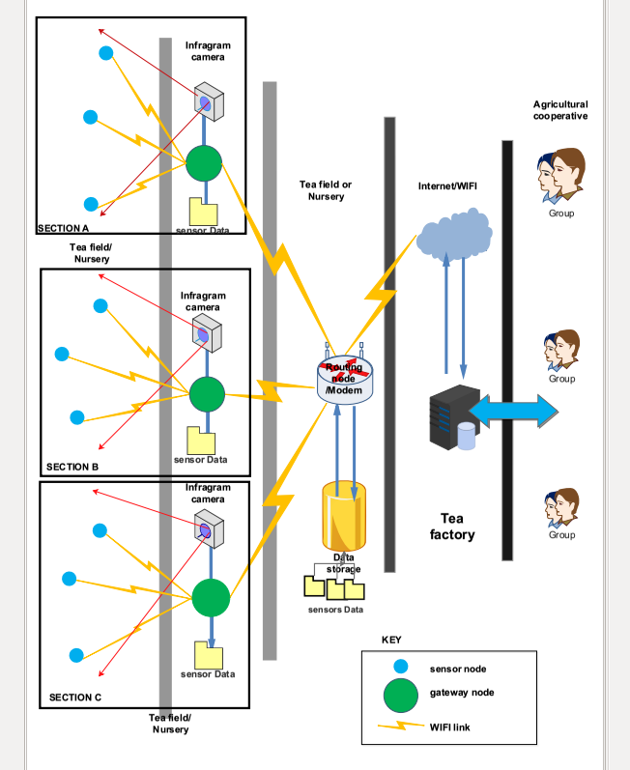
Example of a WSN: tea field monitoring in Rwanda
Environmental data collected by sensor nodes
Data routed to the Internet and aggregated in the cloud
Notes:
Refer to the paper:
Tech4Dev 2016, Lausanne, Switzerland,
Poster [IC05] Raymond Ndacyayisaba, Kobe Institute of Computing, Japan,
“Wireless Sensor Networks for Tea Farm Monitoring in Rwanda”

Slide 6
A solar-powered WSN node
Credit: https://upload.wikimedia.org/wikipedia/commons/4/48/CSIRO_ScienceImage_3876_A_remote_sensing_node_part_of_CSIROs_Fleck_wireless_sensor_network_technology.jpg
Notes:
Explain the role of the typical solar powered WSN node components:
sensors (e.g. temperature, humidity, barometric pressure, light intensity etc.)
wireless communication (e.g.
control unit (CPU+memory controlling the sensors and communication)
solar panel (photovoltaic cells)
battery (to operate when the sun is down)
power control unit (charging control, output regulator)

Slide 7
Other common uses of WSN
Smart city: utilities (e.g. water leakage monitoring), traffic, environment etc.
Intelligent buildings
Health care (e.g. mobile monitoring)
Smart grid
Transport, tracking
Scientific sensing
Notes:
We find many examples on Libelium.
The following slides are taken from there.
Lecturers should add other examples relevant to their main topics.

Slide 8
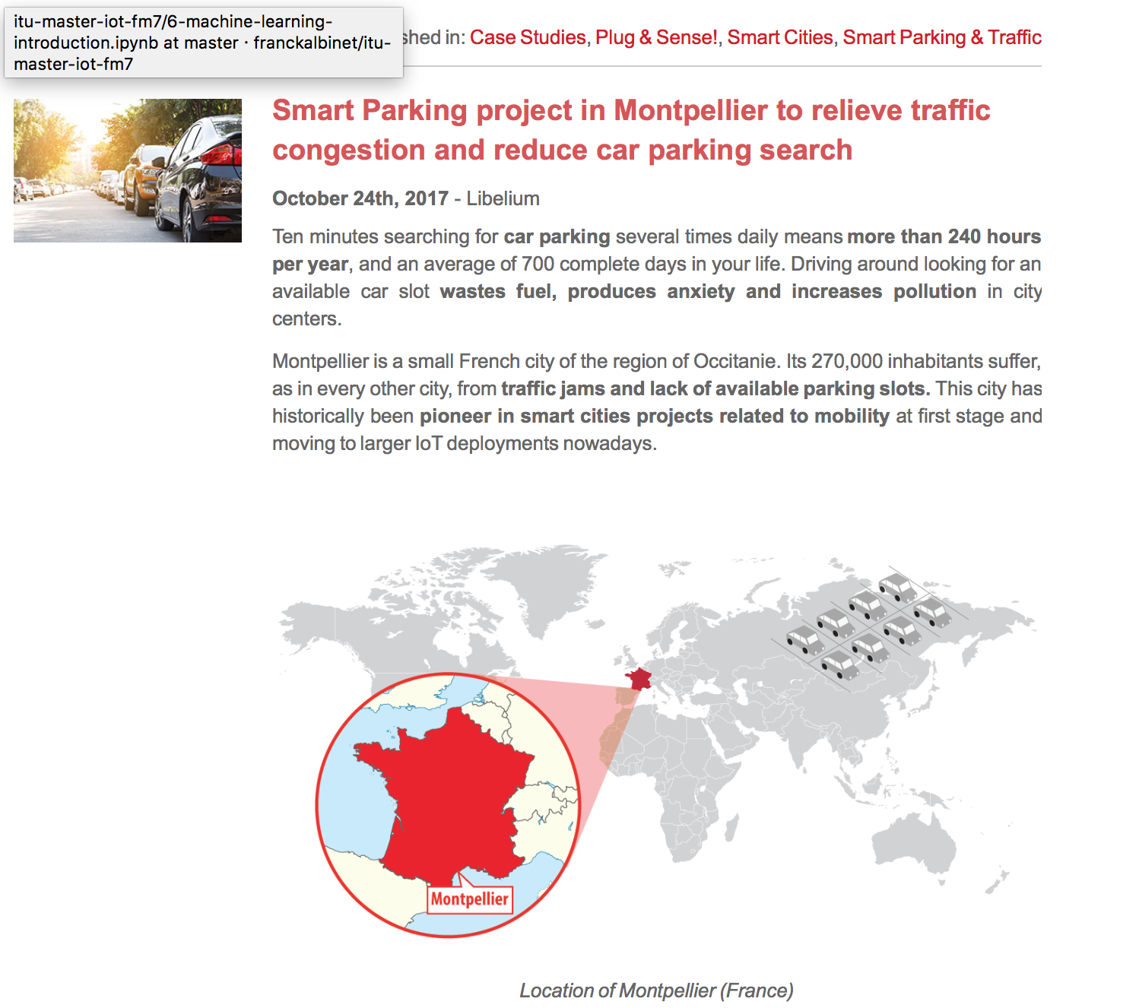
Example: smart parking for smart city
http://www.libelium.com/smart-parking-project-in-montpellier-to-relieve-traffic-congestion-and-reduce-car-parking-search/

Slide 9

Example: smart winery for smart agriculture
http://www.libelium.com/smart-wine-libeliums-iot-technology-allows-predictive-control-of-vineyards-in-the-pago-ayles-winery-spain/

Slide 10

Example: water control with IoT
http://www.libelium.com/controlling-quality-of-irrigation-water-with-iot-to-improve-crops-production/

Slide 11

WSN anomaly detection
A Comparative Study of Anomaly Detection Techniques for Smart City Wireless Sensor Networks
Victor Garcia-Font *, Carles Garrigues and Helena Rifà-Pous
http://www.mdpi.com/1424-8220/16/6/868
Security issues with smart city WSN
Attack detection: find anomalies
Real-world experiment is difficult
Method: detect simulated anomalies
Notes:
A published example of WSN data analysis

Slide 12
Anomaly Detection Methods
Extreme values in Mahalanobis Distance
Local Outlier Factor
Hierarchical Clustering
Classification with Support Vector Machines One-class Support Vector Machines (OC-SVM): Semi-supervised learning with Radial Basis Function (RBF) kernel

Slide 13
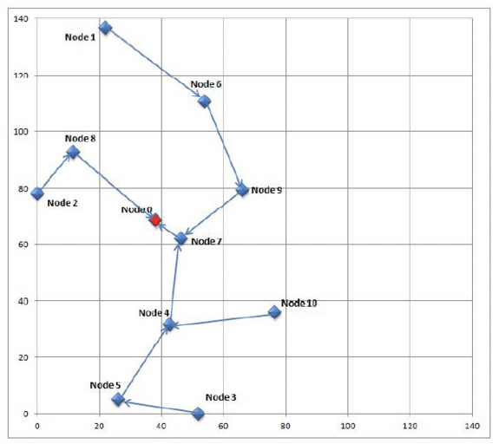
Simulated Smart City WSN
Sound streams collected at 10 locations are reproduced in simulation
http://www.mdpi.com/1424-8220/16/6/868

Slide 14
Feature Selection
Feature Vector 1 (FV1) : number of application packets, hour of the day
Feature Vector 2 (FV2) : FV1 fields, sequence number, battery level, lost packets, consumed energy
Feature Vector 3 (FV3) : FV2 fields, WSN link quality, received MAC ACK and CTS
http://www.mdpi.com/1424-8220/16/6/868

Slide 15
Flow of analysis
The anomaly analysis comprises three basic sub-steps for each of the compared techniques: the training, the validation and the test phases.
…The filtered dataset … [is] divided … in Figure. …The attack samples are not included in the training dataset (a), because the detection techniques … are semi-supervised or unsupervised.
… The validation and test datasets … divided into 8 additional datasets ((b) to (i) in the figure), resulting in a total of 17 datasets (16 + 1 training dataset).
http://www.mdpi.com/1424-8220/16/6/868

Slide 16
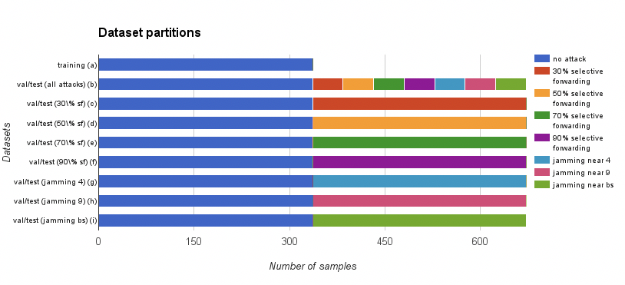
Simulated datasets for training the classifier
http://www.mdpi.com/1424-8220/16/6/868

Slide 17
Training phase
…Normalize and standardize the features in all the datasets (i.e., subtracting the mean and dividing by the standard deviation for each feature), … identify the features that have a zero variance in the training dataset, … removed from the three datasets (i.e., training, validation and test)
… Three different levels of false positive rate: permissive (false positive rate < 15%), restrictive (false positive rate < 10%) and very restrictive (false positive rate < 5%).
http://www.mdpi.com/1424-8220/16/6/868

Slide 18
Validation and test phase
The validation and test datasets are used to evaluate the performance of the algorithms in 72 experiments: (1 with all the attacks together + 7 with each attack separately) x 3 feature vector definitions x 3 PFPR levels.
..Use the detection algorithms to decide whether each sample has to be considered as an attack or not, …
count the correct identifications of attacks as true positives, the incorrect identifications of attacks as false positives, the correct identifications of no attacks as true negatives and the incorrect identifications of no attacks as false negatives.
http://www.mdpi.com/1424-8220/16/6/868

Slide 19
Results sorted by True Positive Rate (TPR)
OC-SVM dominates
http://www.mdpi.com/1424-8220/16/6/868

Slide 20
Discussion
Compare the TPR (True Positive Rate) for the four methods
What is the reason for requiring low FPR (False Positive Rate)? What happens with many false positives?
Consider other anomaly situations; how to weight TPR vs. FPR? When would we allow many false alarms in return for finding all attacks?

